Slide 1



SMART INDIA HACKATHON 2025
TITLE PAGE
Problem Statement ID – 25010
Problem Statement Title- Smart Crop Advisory System for Small and Marginal Farmers.
Theme- Agriculture & Rural Development
PS Category- Software
Team ID- 90SD579
Team Name (Registered on portal) – Soil2Software

Slide 2

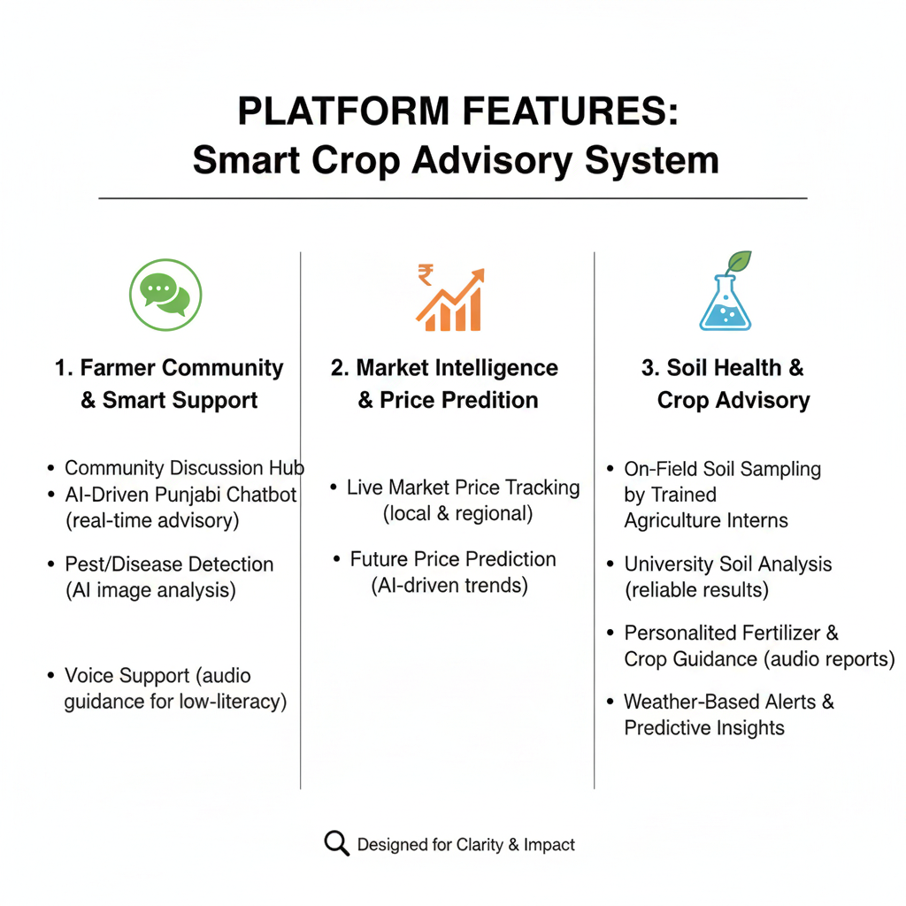
IDEA TITLE
Problem : A majority of small and marginal farmers in India rely on guesswork and informal advice for crop, pest, and fertilizer decisions, lacking real-time, personalized guidance which results in low yields, high input costs, and environmental harm, worsened by language barriers and low digital access.
Solution Idea :
Additional Features :
Weather-based alerts and predictive insights.
If multiple farmers in region report the same disease, the system alerts all farmers for timely preventive action.
Guidance Video’s prepared by University students.
2

Slide 3
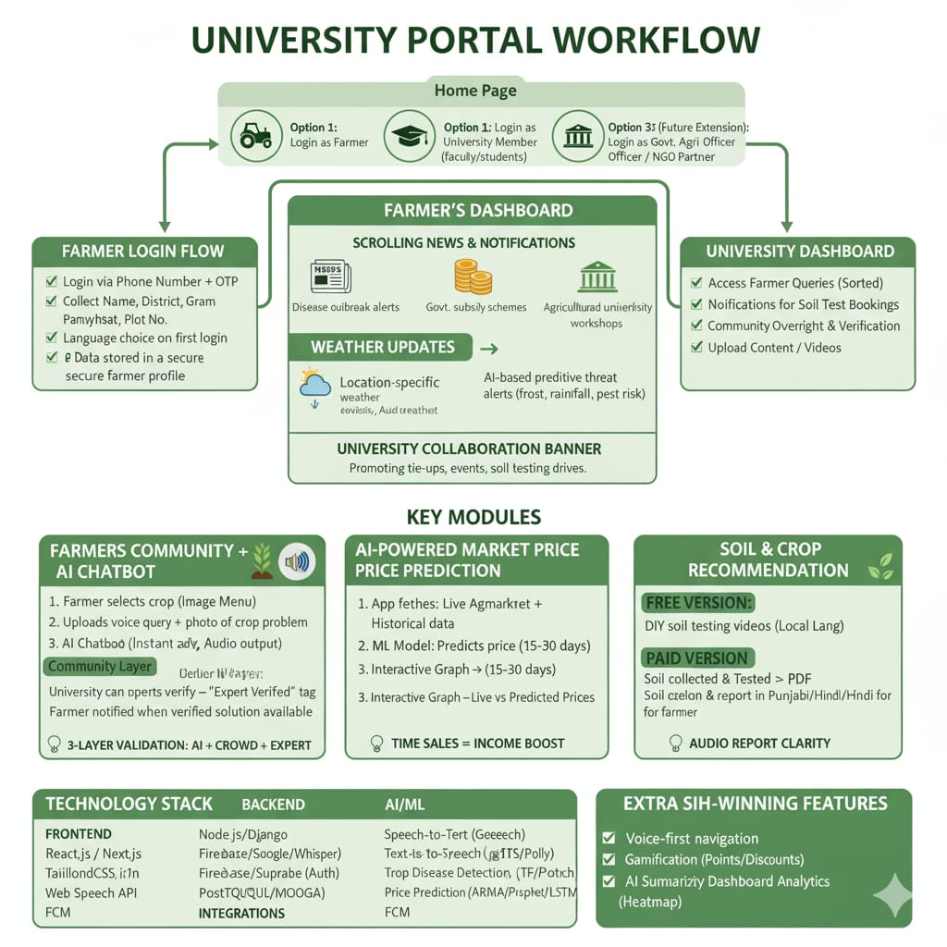
TECHNICAL APPROACH

Slide 4
FEASIBILITY AND VIABILITY
Feasibility & Viability :
Technical Feasibility
Uses existing university soil labs and a simple mobile/web platform for data entry and report sharing.
Field sampling done by trained agriculture interns, ensuring accurate sample collection and standardized testing.
Soil report will be delivered to farmers verbally either through audio messages or phone calls enabling even illiterate or low-marginal farmers to easily understand this critical information.
Economic & Operational Viability
Low cost model: Students work as part of their internship, reducing manpower expense.
Universities and agricultural departments already have testing infrastructure—no need for new expensive equipment.
Provides dual benefit: real-world training for students (smart education) and affordable soil health service for farmers.
⚠️Potential Challenges & Risks
Logistics & Timeliness
Farmer Participation
Resource Management
Data Management & Security.
Strategies to Overcome
Efficient Scheduling: Create a digital booking system to plan visits and batch sample processing.
Local Engagement: Involve village leaders and local agri-officers to build trust and encourage farmer participation.
Turnaround Monitoring: Set strict timelines for lab testing;
use automated alerts for delays.
Data Platform: Build a secure central database with unique farmer IDs for easy tracking and privacy compliance.
Student Training & Incentives: Pre-train interns in sample collection and farmer communication; provide certificate /credits to ensure commitment.

Slide 5
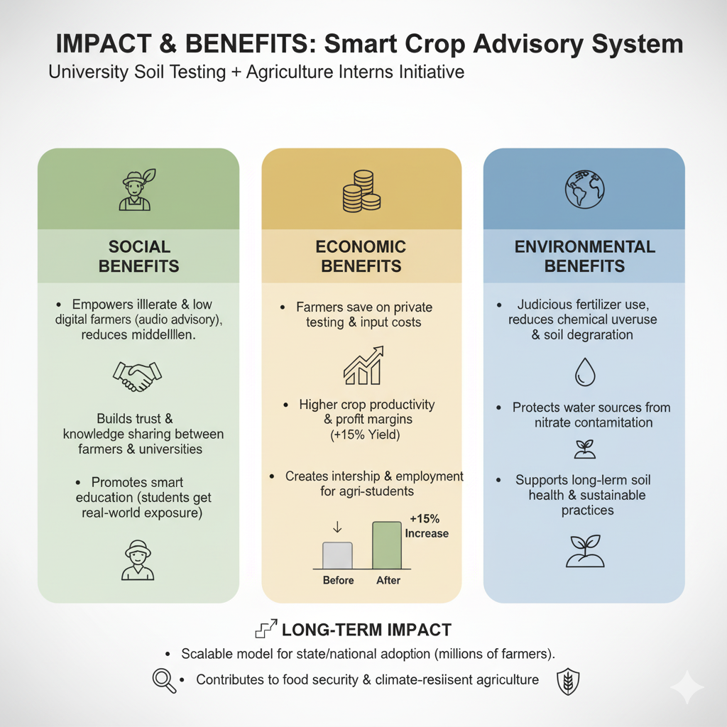
IMPACT AND BENEFITS
FUTURE SCOPE
Automated Soil Sensors & IOT
Integrate low-cost sensors for reaime soil moisture/nutrient tracking.
Government Scheme Integration
Direct linkage to subsidy, crop insurance and PM-Kisan benefits.
Multi-Language Expansion
Add more regional languages and dialect for nationwide coverage.
AI Disease & Pest Forecasting
Use satellite imagery + community reports to predict regional outbreaks.
Farmer Marketplace
Enable direct buyer-seller connection for product sales.

Slide 6
RESEARCH AND REFERENCES
Case Studies :
The official Government of India portal for the SHC scheme, providing a model for soil data management and farmer-facing reports. https://soilhealth.dac.gov.in
An example of a commercial API providing polygon-based, field-specific soil data for precision agriculture. https://farmonaut.com/precision-farming/precision-agriculture-boost-yields-with-soil-data-apis
A technical guide for building a multilingual chatbot using Lang Chain and translation APIs, mirroring the 'Saathi' chatbot design
https://www.analyticsvidhya.com/blog/2025/02/agri-bot-ai-for-farmers/
Punjab Agricultural University (PAU) https://www.pau.edu/
https://news.climate.columbia.edu/2009/07/28/punjab-a-tale-of-prosperity-and-decline/

